Slide 1
Competitive Analysis - Portfolios
By Philip Ku

Slide 2
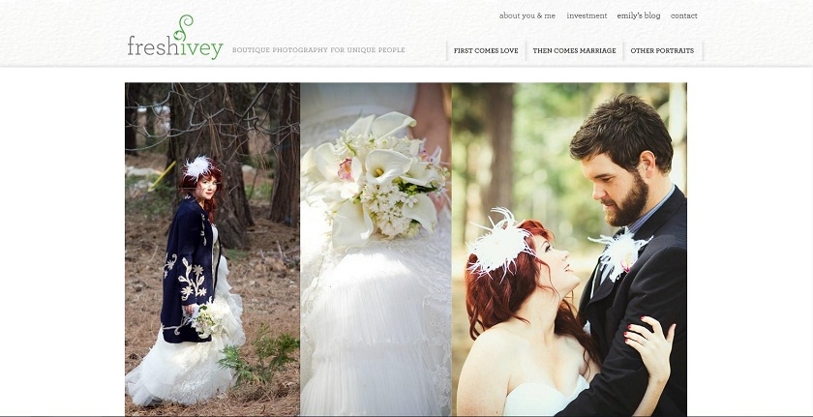
1) Fresh Ivey Photography
www.freshivey.com
Date visited: 1/17/12
Layout – Featured Photo

Slide 3
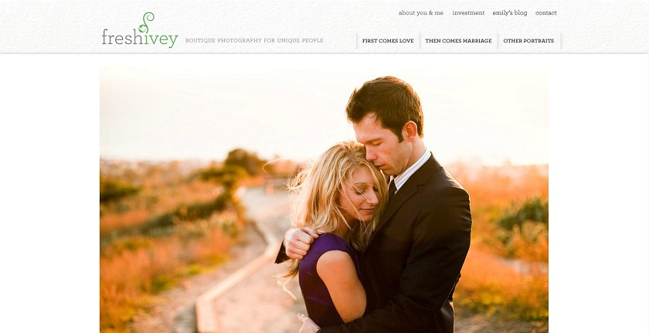
Brand
Clean – White background. Not very flashy. Brings focus the photos.
Natural – Most photos involve nature. ‘Ivey’ as a theme.
Beautiful - Accentuates the beauty of photos. Leaves no distraction.

Slide 4
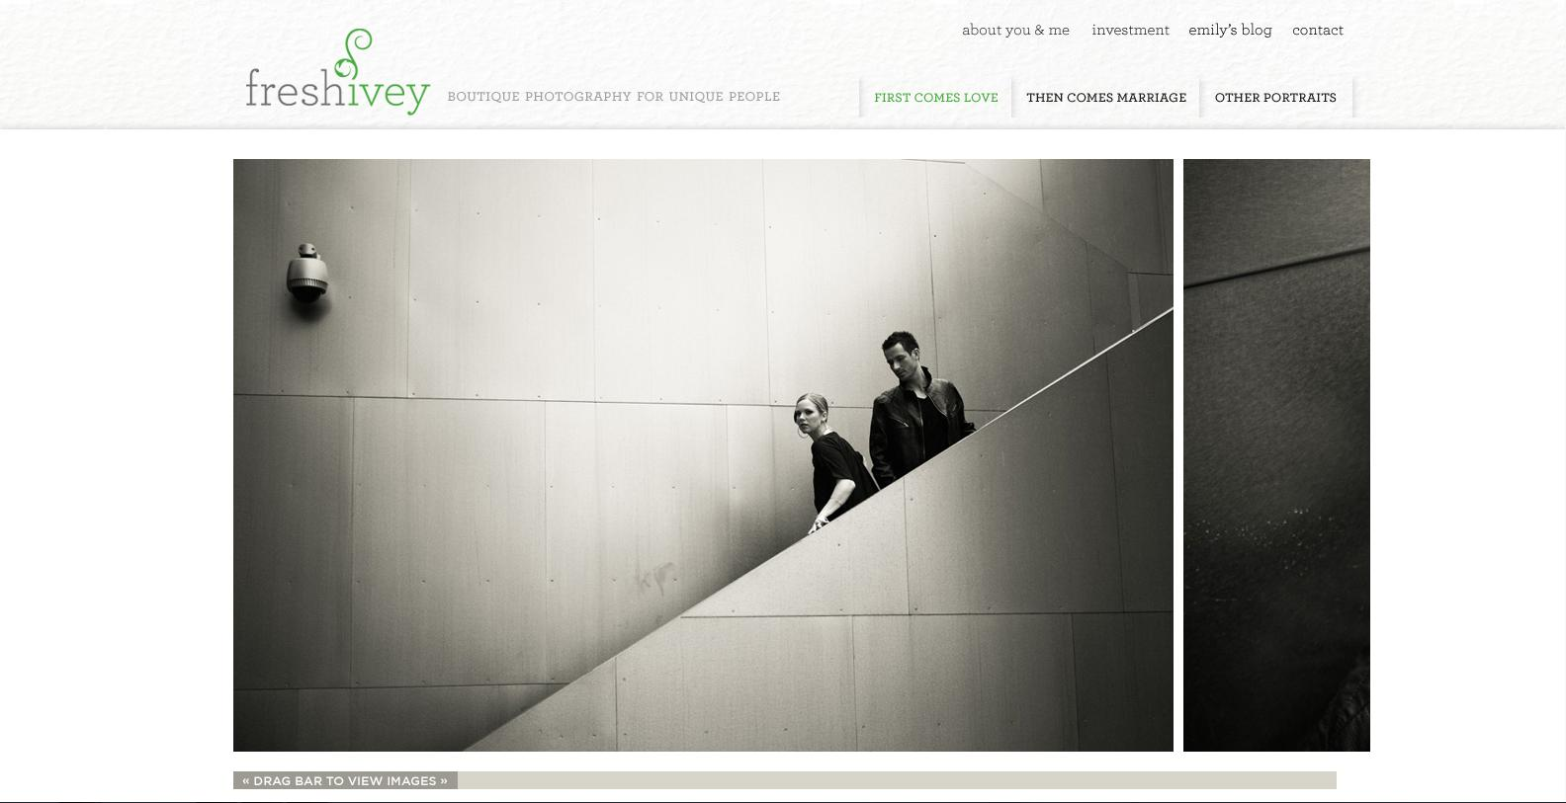
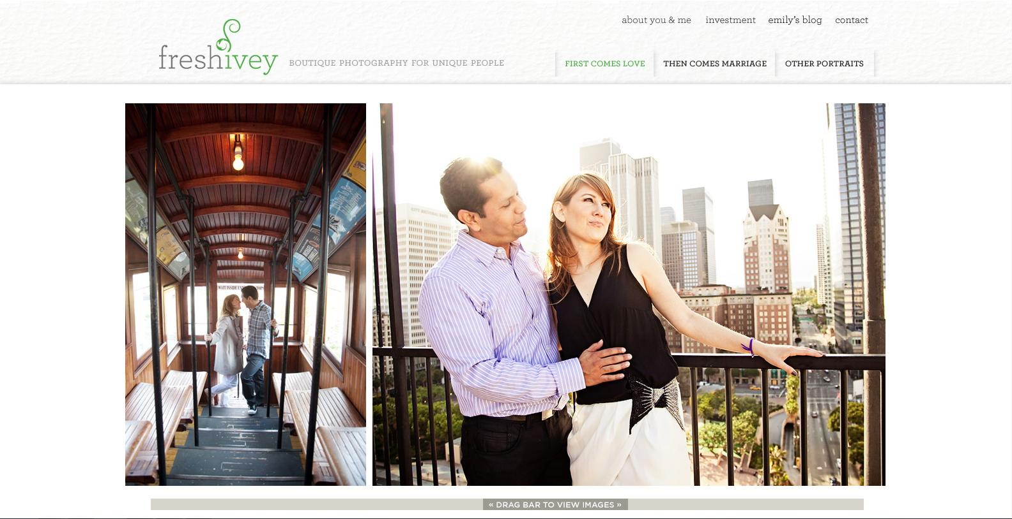
Functionality
There is an interesting side-scrolling function for viewing images. The only problem I see is that the scroll bar auto-centers itself when you select it, which also moves the image. It makes it seem choppy. However, when the page is first loaded, it moves with mouse scrolling if you have a wheel.
The 3 Tabs showcase different types of photos.
You cannot enlarge the images. However, they are already pretty big, so it’s not really a problem.

Slide 5
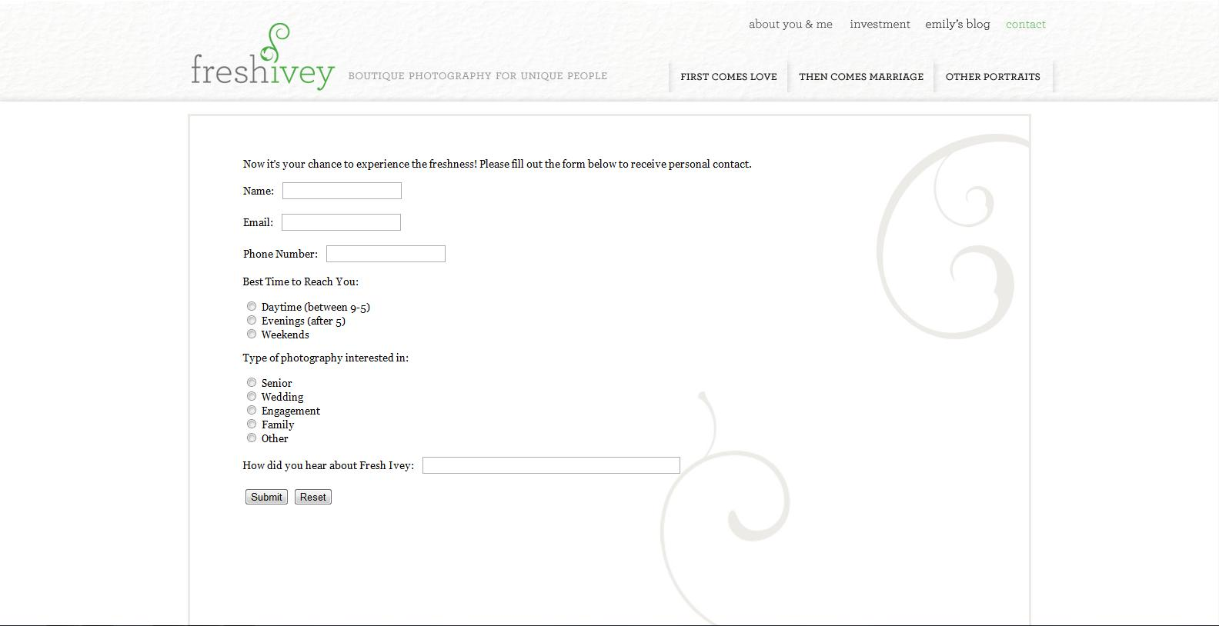
Interactivity
There isn’t much interactivity aside from the tabs to select different photos.
You cannot select the photos.
The home page automatically showcases different photos.
There is a page where you can submit info to contact the person.

Slide 6
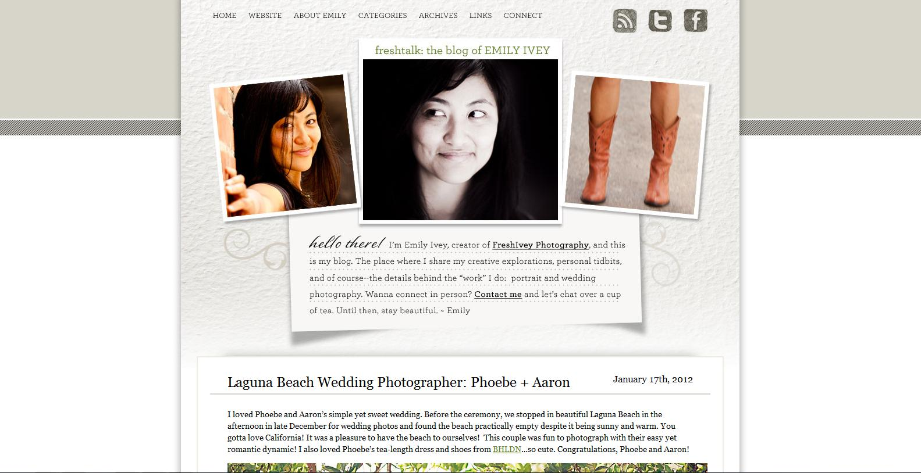
Navigation
Very simple and easy. There are tabs to every page available. The tabs are always at the top of the page. Clicking the name of the site brings you back to the home page.
There are more pages in her blog, but the layout is relatively the same.

Slide 7
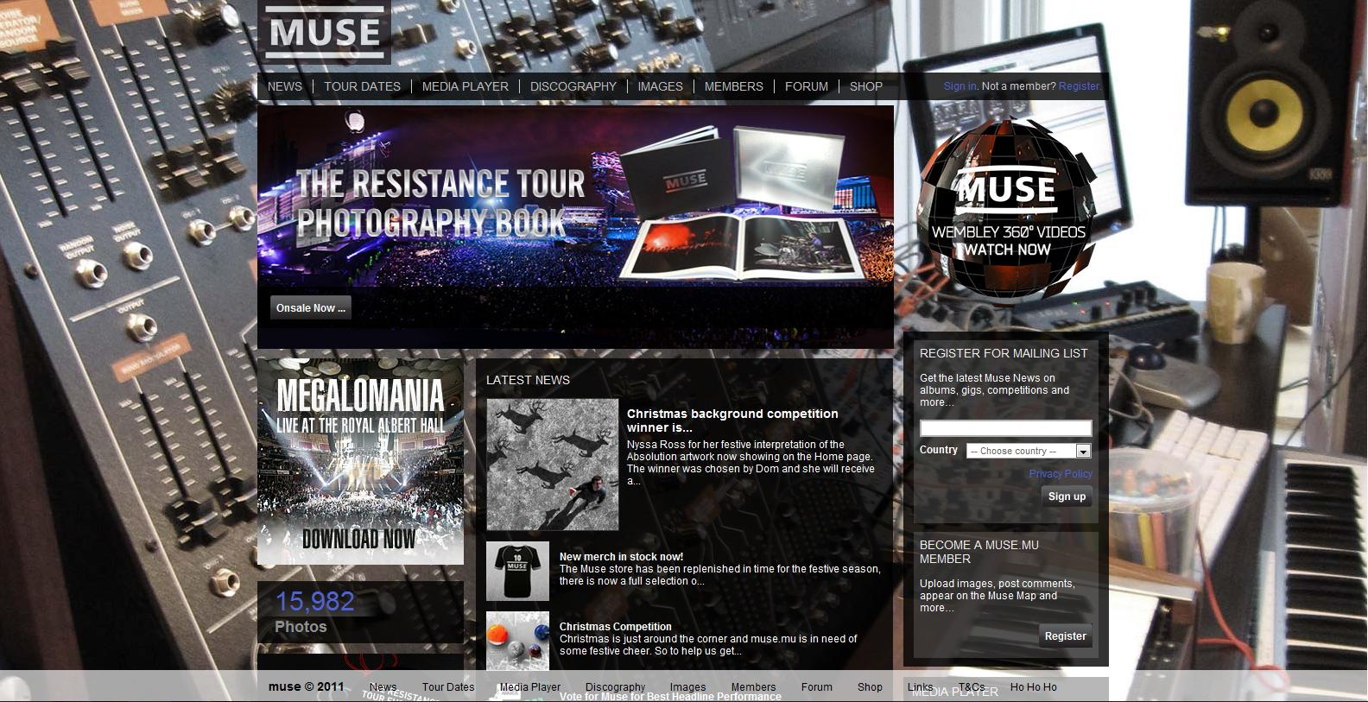
2) Muse
www.muse.mu
Date Visited: 1/17/12
Layout – Power Grid

Slide 8
Brand
Professional - They have loads of information, even archives.
Social – Inviting you to become a member, join the forums, check out photos/videos, etc.
Prestigious – The fact that the can fill a Power Grid layout means that they have a lot of media and experience in making music.

Slide 9
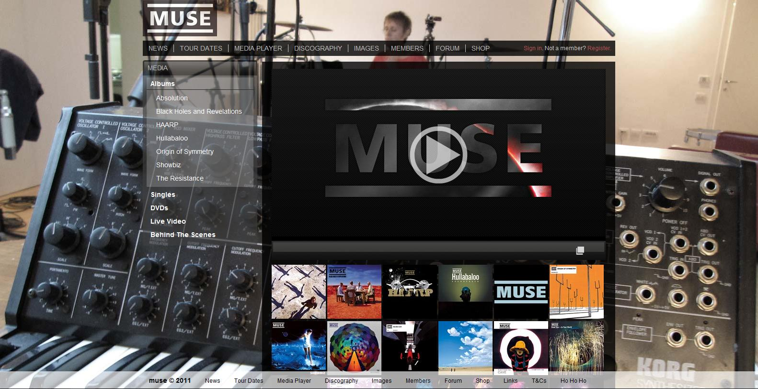
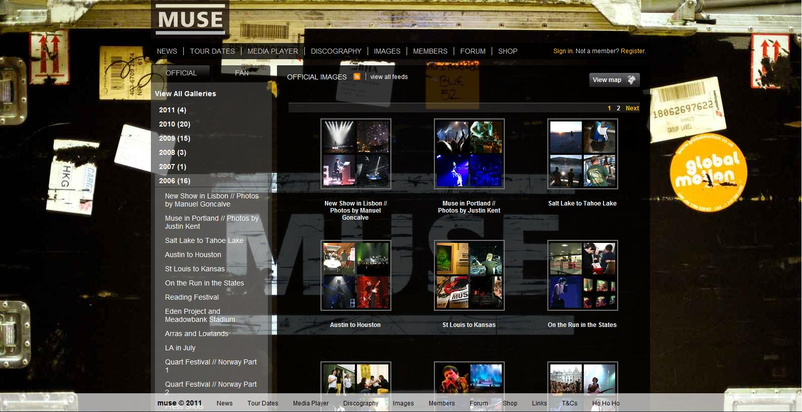
Functionality
Each tab opens up a new page with a sidebar.
The links on the sidebar open up after being selected to reveal more options.
Every picture on the right-hand side can be selected to view that piece of media.
Different pages have similar layouts.
This makes viewing every form of media easy.

Slide 10
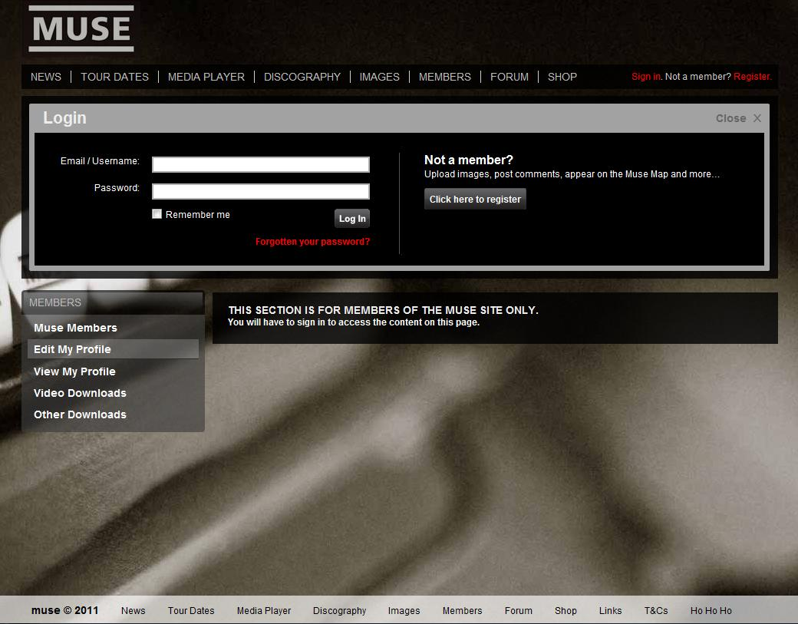
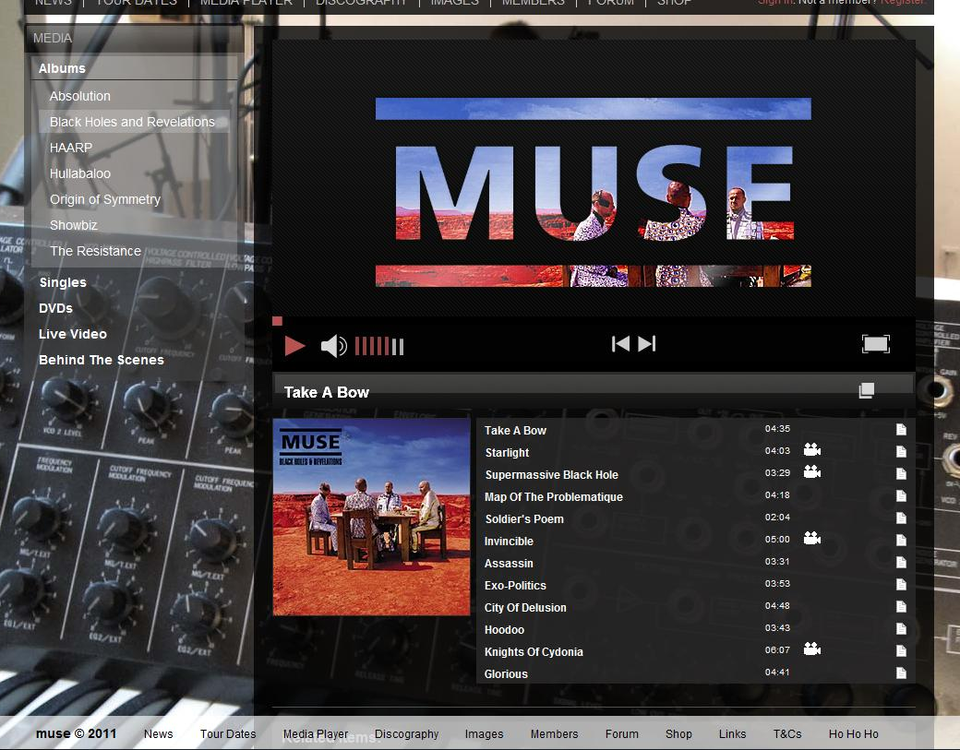
Interactivity
The top links are not highlighted when selected, but the sidebar selections are.
When the mouse falls on a link, it lights up.
Their video/audio streams allow you to see/hear what they do. You can select the song, album, change the volume, etc.
You can also join their network and socialize with other members.

Slide 11
Navigation
Top navigation bar is there on every page. Sidebars have drop-down menus that come down after selecting it.
Relatively easy to know where you are and where you can go.
There is also an extra navigation bar at the bottom.
It seems extraneous, but there are some extra links there that aren’t at the top.

Slide 12
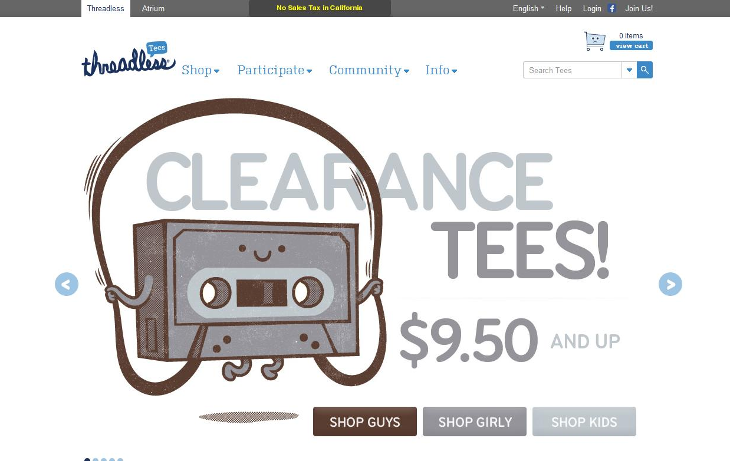
3) Threadless Tees
www.threadless.com
Date Visited – 1/19/12
Layout - Custom (Five Boxes + Headline & Grid)

Slide 13
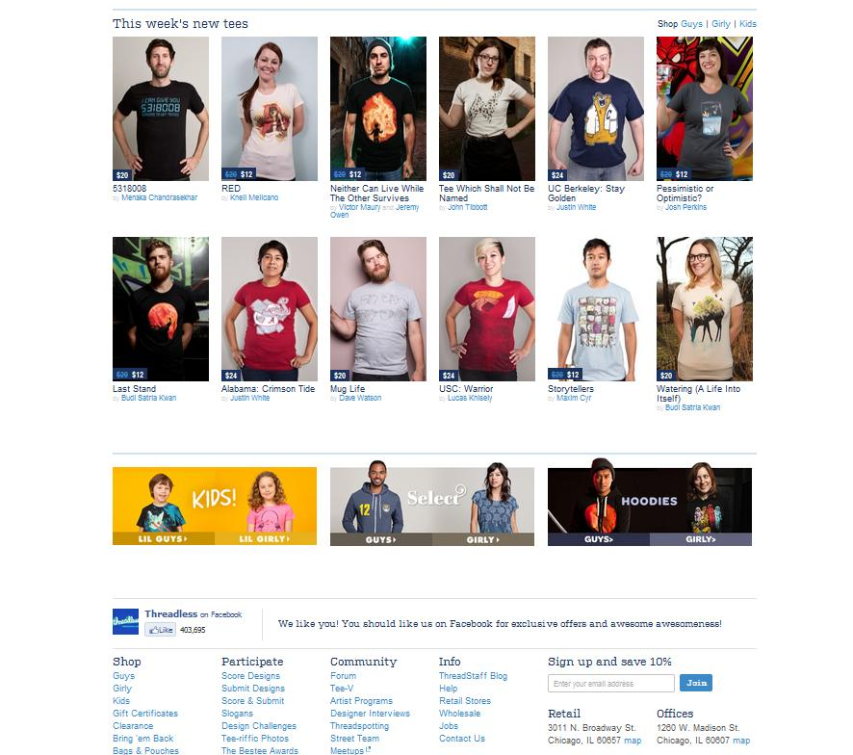
Brand
Fun – The art style on the shirts seems fun.
Artistic – Many creative designs
Social – Shopping, members, community tab. Encourages participation.

Slide 14
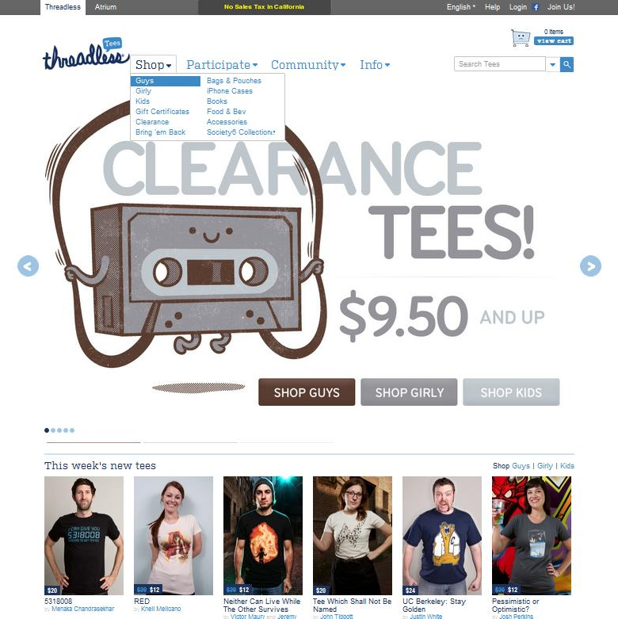
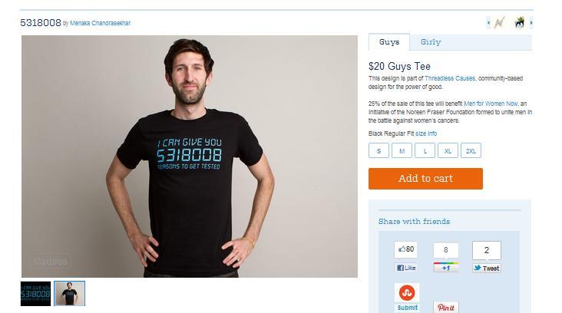
Functionality
The tabs have drop down menus to show what other products there are.
Shopping cart to keep track of sales.
The main image has links within it that you may browse.
A section displays the newest designs.
Selecting a shirt will bring you to a new page showcasing that shirt.

Slide 15
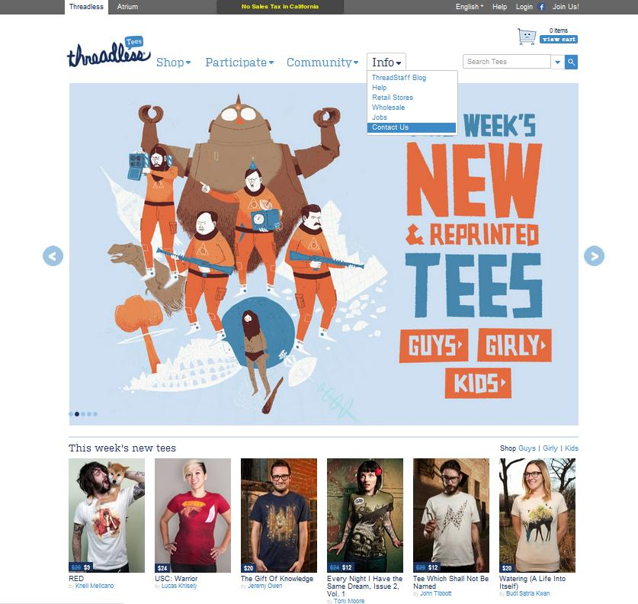
Interactivity
Main tabs have drop-down menus. Mouse-over highlights your selection.
There are arrows that you can select to scroll through the main images. You can also click the circles to browse.
The main image also has links to select.
Clicking on a shirt will bring you to a new page to show you more details about the shirt.
The top grey tab allows you to change the language. You can also join the community by registering with the site.

Slide 16
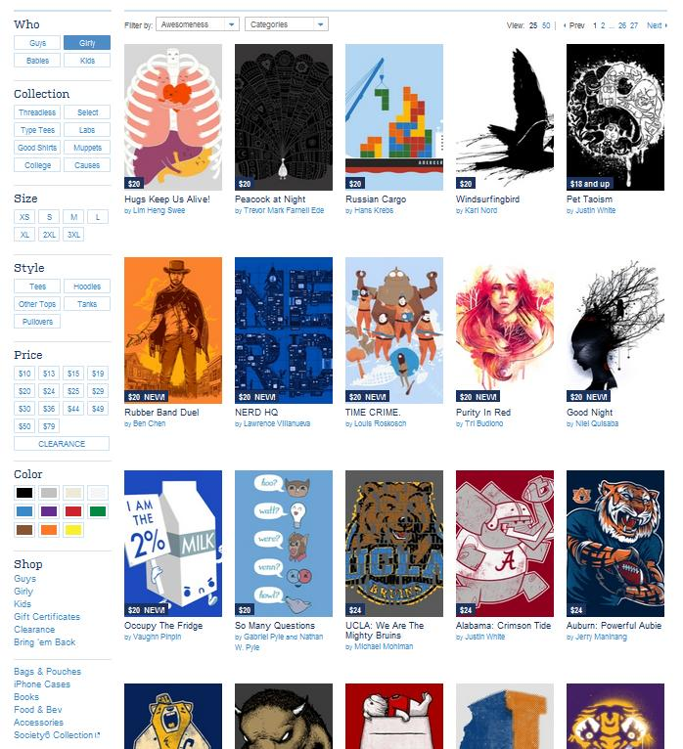
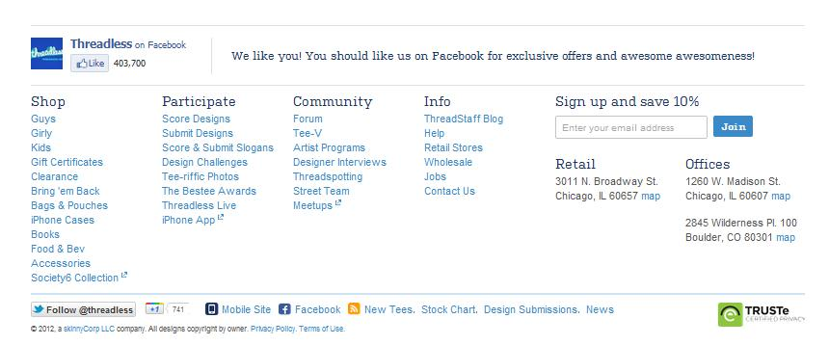
Navigation
Easy to find what you want. Selections are on the side tab for what kind of shirt you want, including size, color, etc..
Selecting a shirt will bring you to that shirt’s page. This page lists more info about the shirt, including comments about the shirt and suggestions for other shirts.
You can also select the designer’s name to see more of his/her works.
You can browse through all the pages of shirts available.
The top tab is present on every page, so you can always go back to a main section. There is also a section at the bottom of the site with every link.

Slide 17
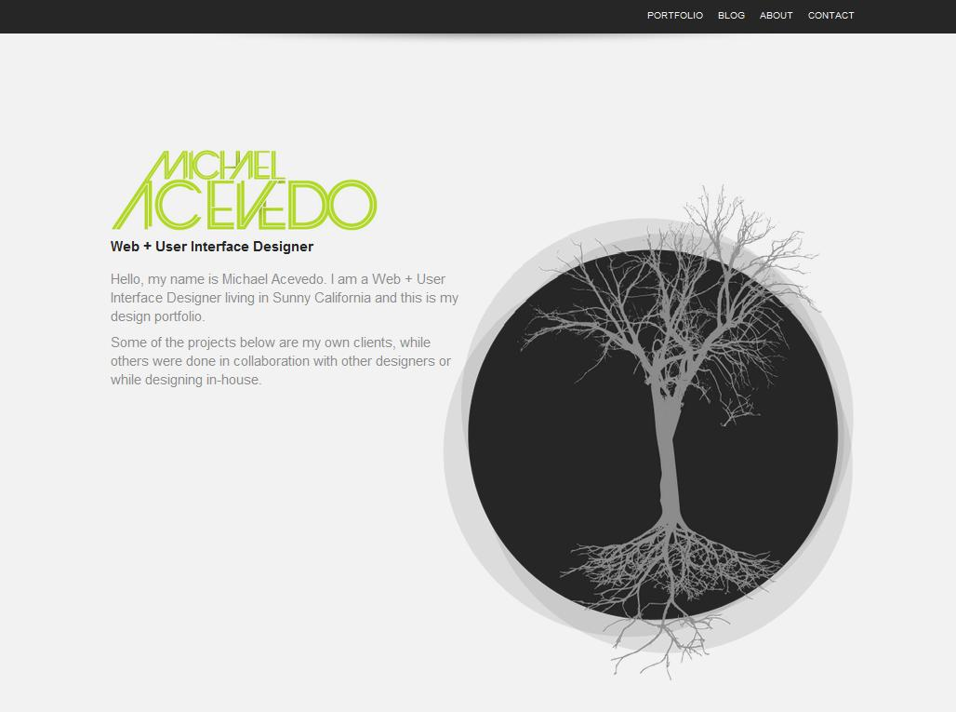
4) Michael Acevedo
michaelacevedo.com
Date Visited: 1/19/12
Layout: Featured Graphic

Slide 18
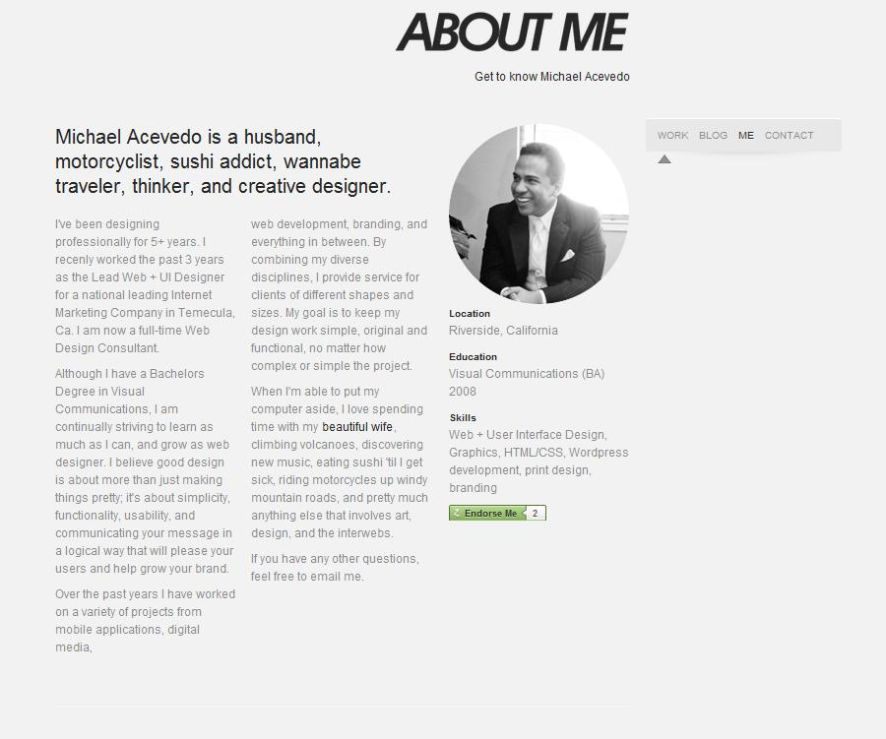
Brand
Clean – The simple white, gray, and black colors give a clean feel.
Casual – They way he writes is friendly, personable, and not too serious.
Skilled – He demonstrates his skill through his smooth transitions.

Slide 19
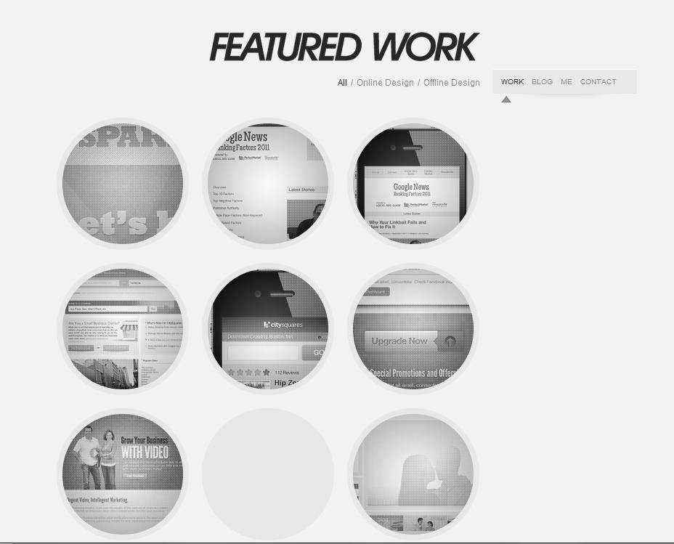
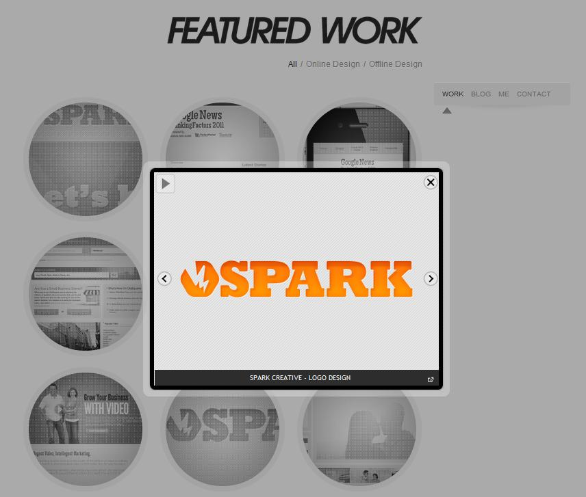
Functionality
Instead of having different pages, he has all his info on a single large page.
You can either scroll through or use the little navigation bar on the right side which will slide you to the section you select, which is a nice transition.
Selecting a picture will bring up a display of the site and a description of how he contributed to the site.

Slide 20
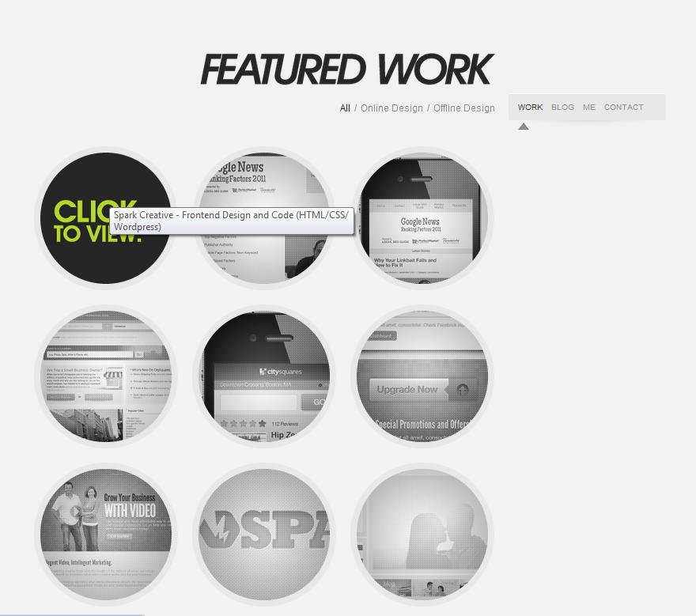
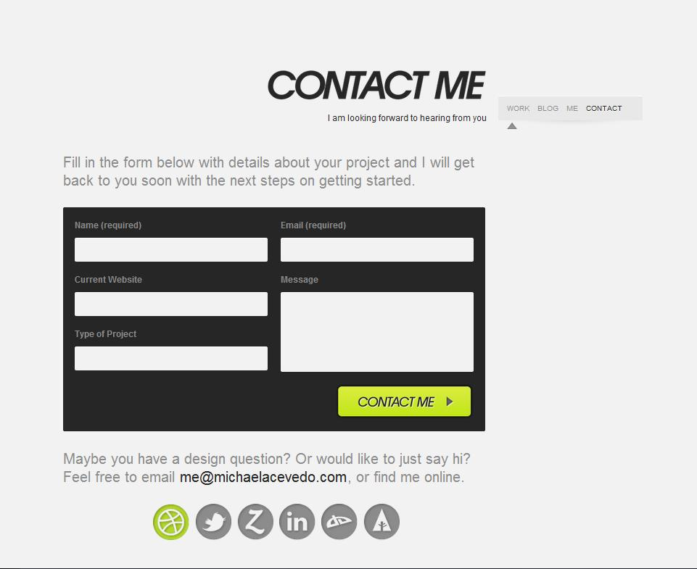
Interactivity
You can select each work to view it.
A mouse-over will change the image. However, the image might not reappear after moving your mouse away.
When viewing a design, you can manually view each one or start a slideshow.
You can also fill out this form to contact him.

Slide 21
Navigation
Since it is all on one page, navigation is simple. It is made easier by the top bar and the sidebar, which only appear after the top bar moves off-screen.
Moving back to the home page from selecting a design is easily done by clicking away from the image or clicking the exit button.

Slide 22
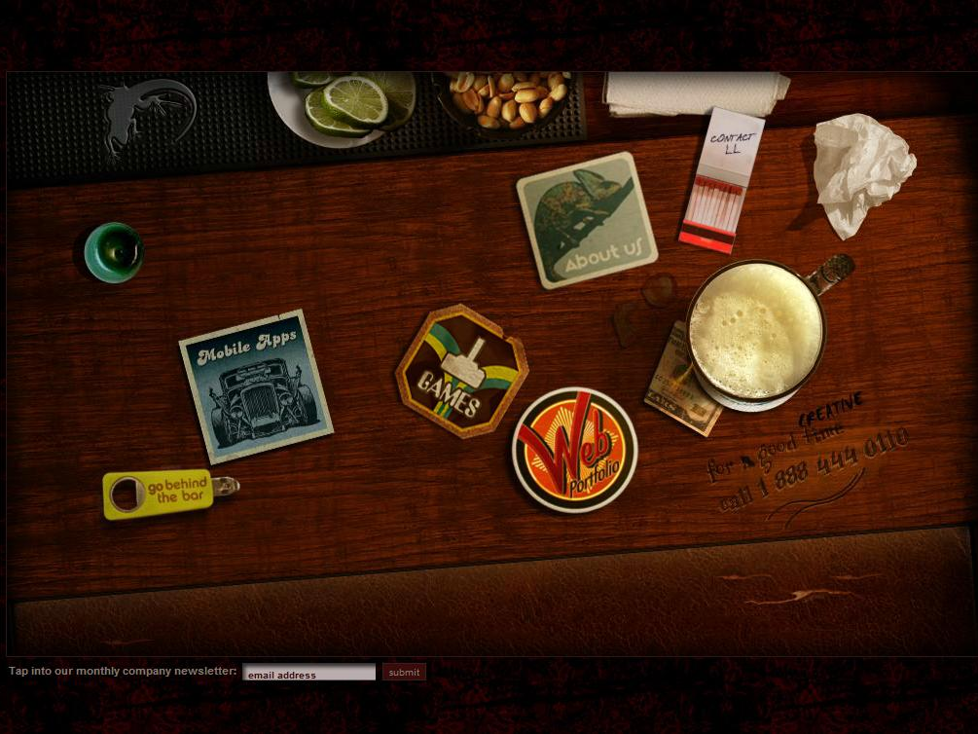
5) Lounge Lizard
www.loungelizard.com
Date Visited: 1/19/12
Layout – Custom (Interactive)

Slide 23
Brand
Creative – A fully interactive homepage with a bar theme. Each link is associated with an image that moves when moused-over.
Skilled – It takes skill to create such a homepage.
Fun – There are games and small extras on the site just for fun. (You can light the candle)

Slide 24
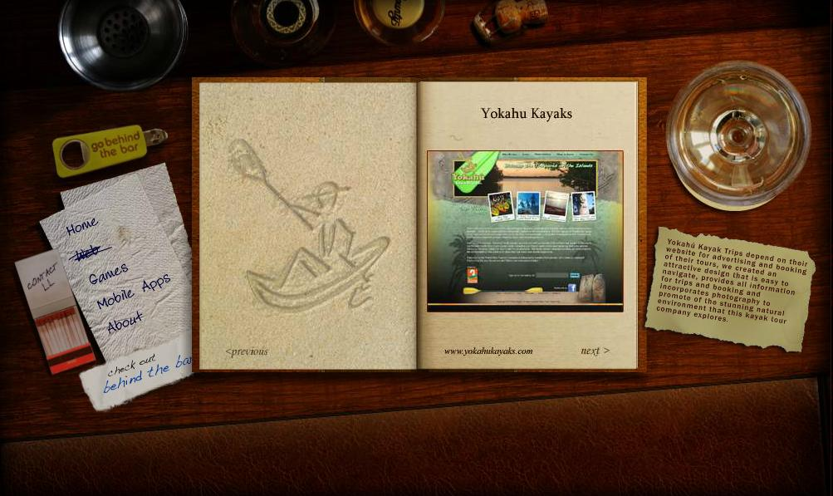
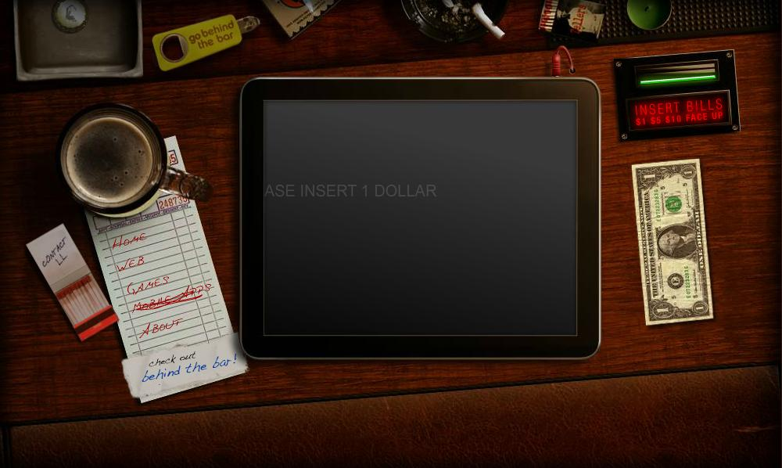
Functionality
Aside from the actual site to demonstrate their skill, they also have a web portfolio for people to see what other woks they have done.
They also explain their ideas behind each design on the right.
Although the site may seem confusing at first, there are breadcrumbs to lead you toward the right direction.
The text is scrolling across the screen to tell you what to do.

Slide 25
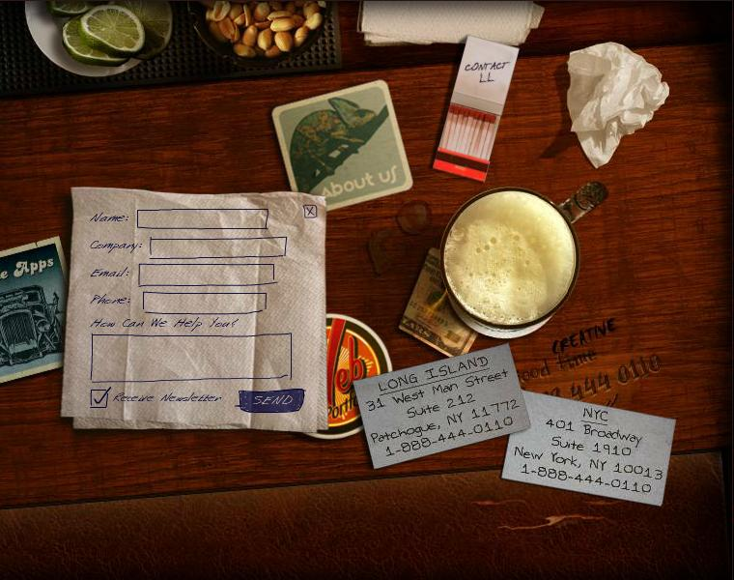
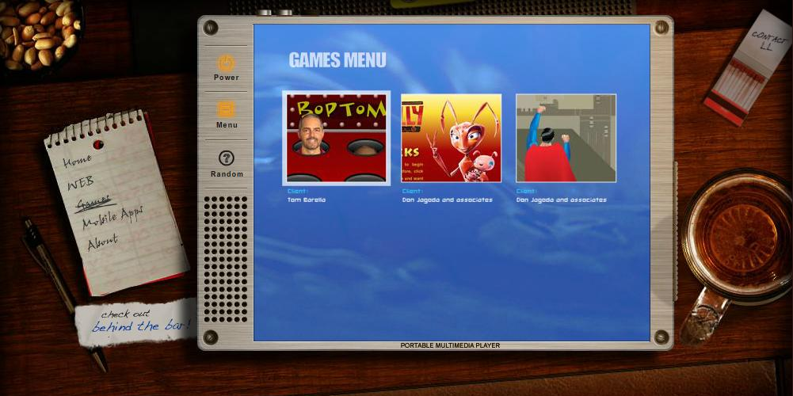
Interactivity
The site is almost completely interactive. You cannot get any information without interacting with the site. This might provide usability issues.
You can even play games on the site!

Slide 26
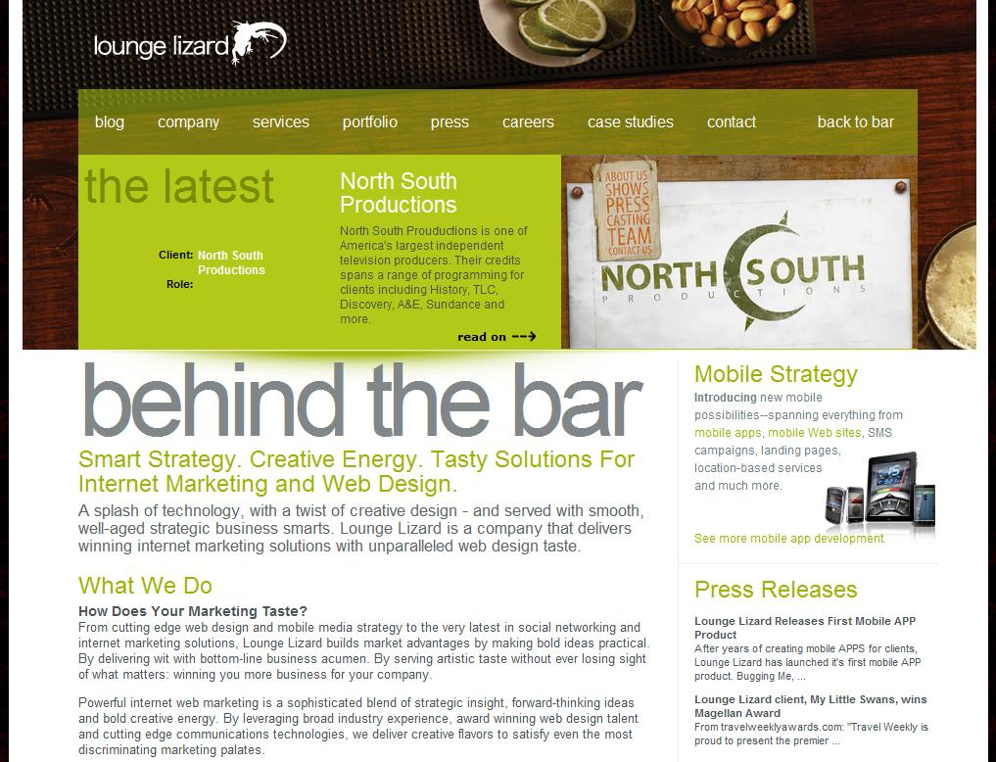
Navigation
Even though the site is fully interactive, it is still easy to navigate. All the links are named. There is an indicator to tell you what page you’re on. Every page has a link to all the other pages.
However, for a more professional look, there is a link to see ‘Behind the Bar’. This is basically a more conventional site. This page is definitely more professional looking. It has tabs with even more information, and even a link to return to the bar interface.

Slide 27
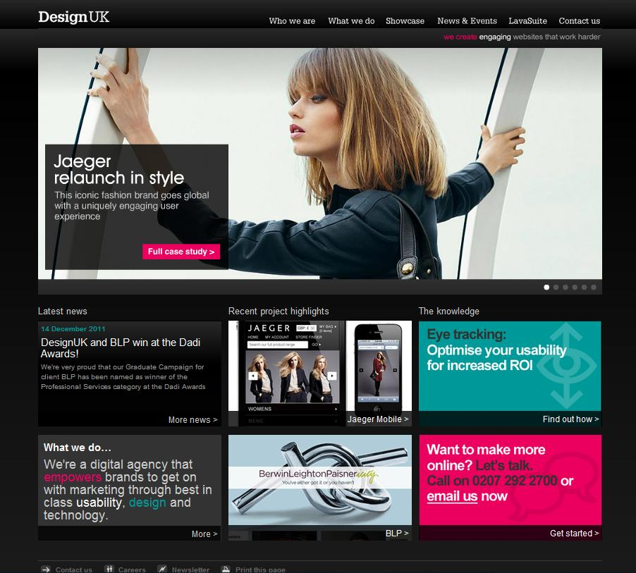
6) Design UK
www.designuk.com
Date Visited: 1/19/12
Layout: Headline & Grid

Slide 28
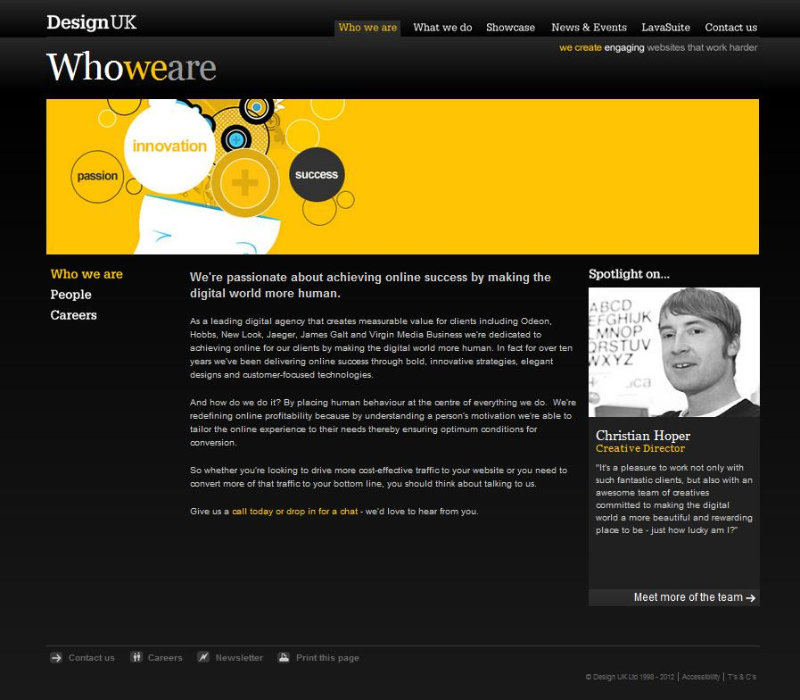
Brand
Clean – Simple background. Not very colorful. Layout is easy on the eyes.
Professional – Lots of text describing who they are and what they do.
Experienced – Their text and showcase display that they are knowledgeable about their field

Slide 29
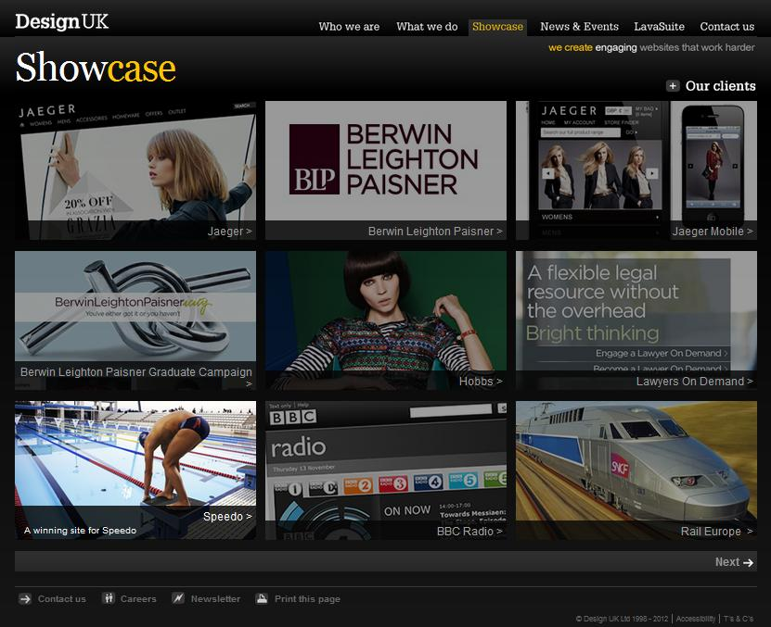
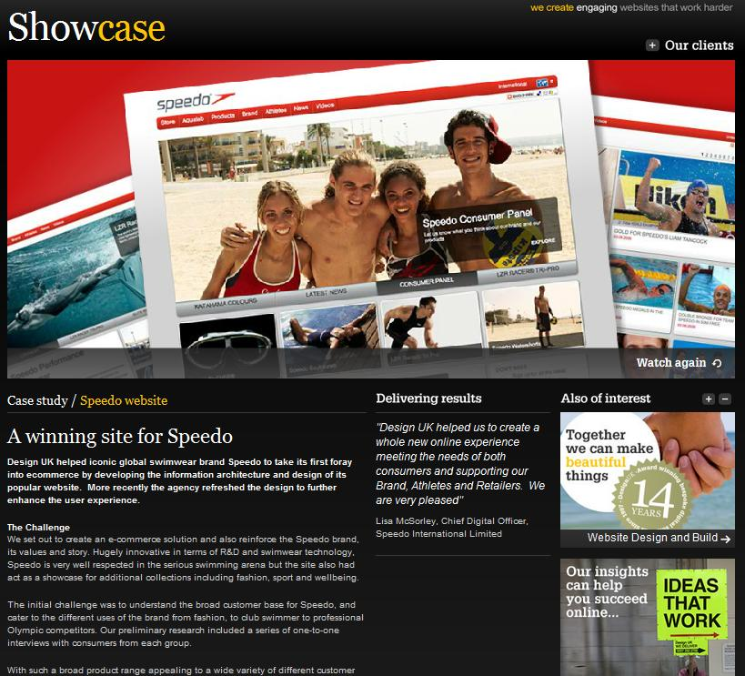
Functionality
Easy and simple to use. The top tabs lead you to wherever you want to go and remain there for every page. It’s easy to tell where you are and where you can go.
Selecting their works will bring you to a detailed page about their work on the site.

Slide 30
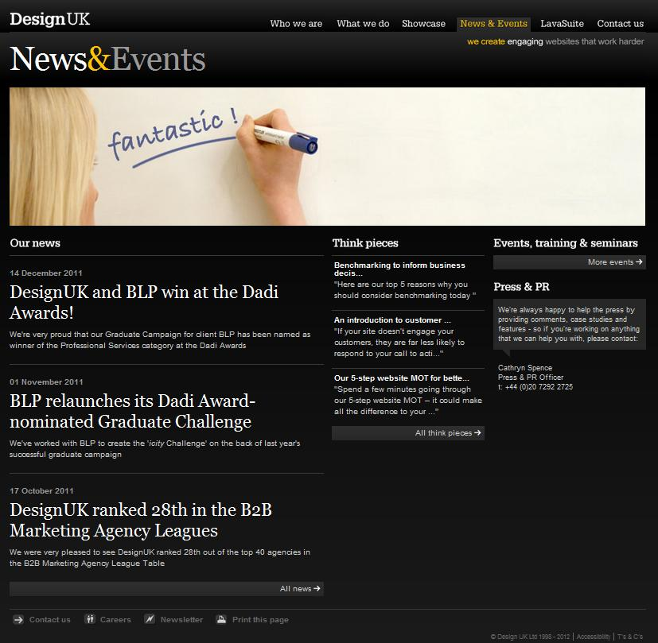
Interactivity
There is not much interactivity on this website. It consists mostly of links and mouse-overs.
The links mostly bring you to a new page. There are no drop-down menus. However, there are side tabs that may show up on a page.

Slide 31
Navigation
Navigation is pretty simple and self-explanatory.
The top tab is always there to guide you back a any main page.
Within each page there may be a sidebar with more links.
One thing is that after selecting a design in the showcase, you cannot return to the page displaying all of them. You can only choose to view the next or previous site. To return to the showcase

Slide 32
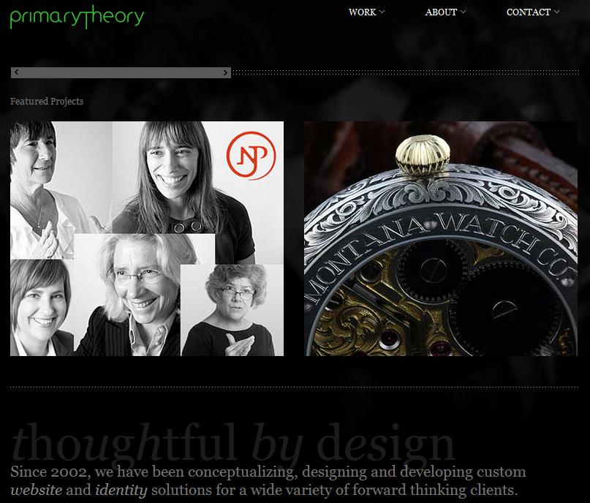
7) Primary Theory
www.primarytheory.com
Date Visited: 1/19/12
Layout – Custom (2D Screenshots + Headline & Gallery)

Slide 33
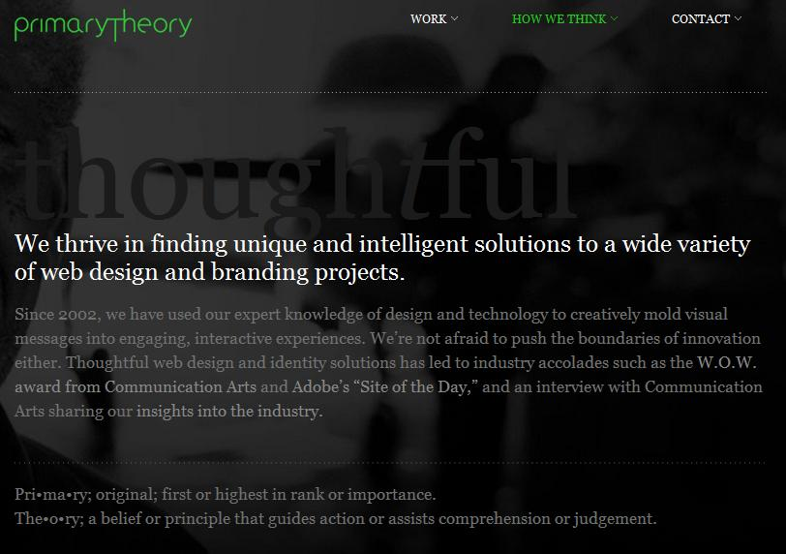
Brand
Unique – Stresses their focus on originality in design. Part of the history behind their name.
Clean – Not too flashy. Simple background and color scheme.
Experienced – Their showcase is very broad, demonstrating the diversity among their works.

Slide 34
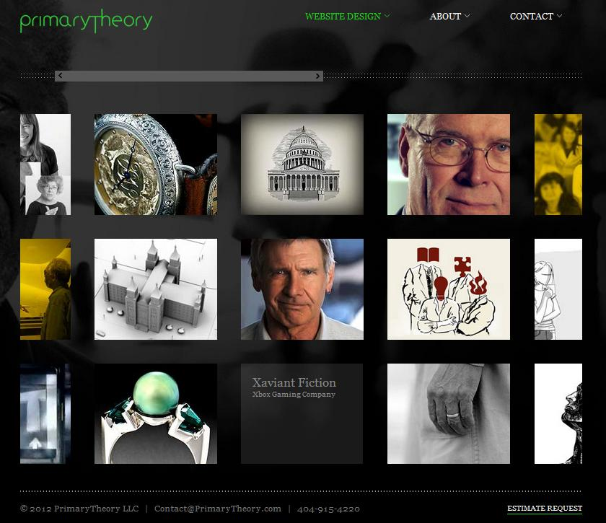
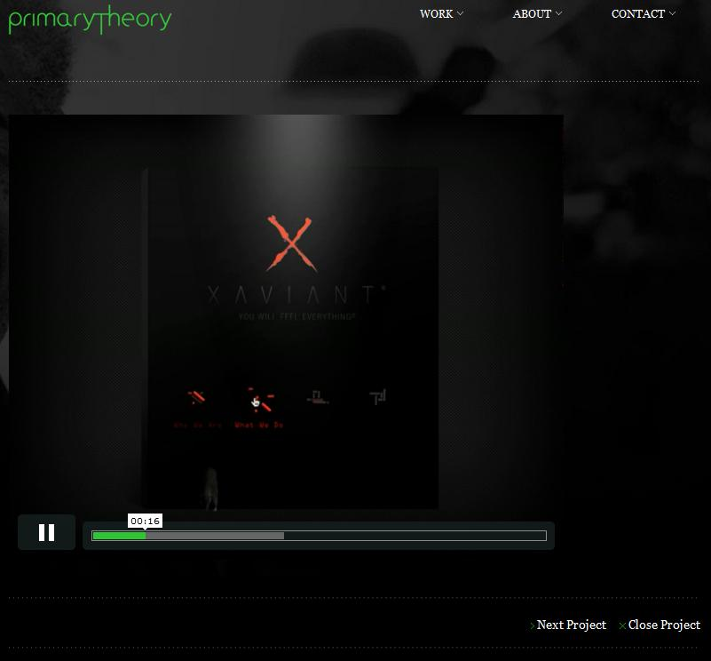
Functionality
The top tab guides you to every page.
There are two showcases both in this side-scrolling grid format. Selecting a photo will bring you to a video which will run you through the website they designed. There is also a link to the website itself.
I also enjoyed that they have a page for customer feedback. I had not seen one yet. It is very effective for showing how well they can do their job.

Slide 35
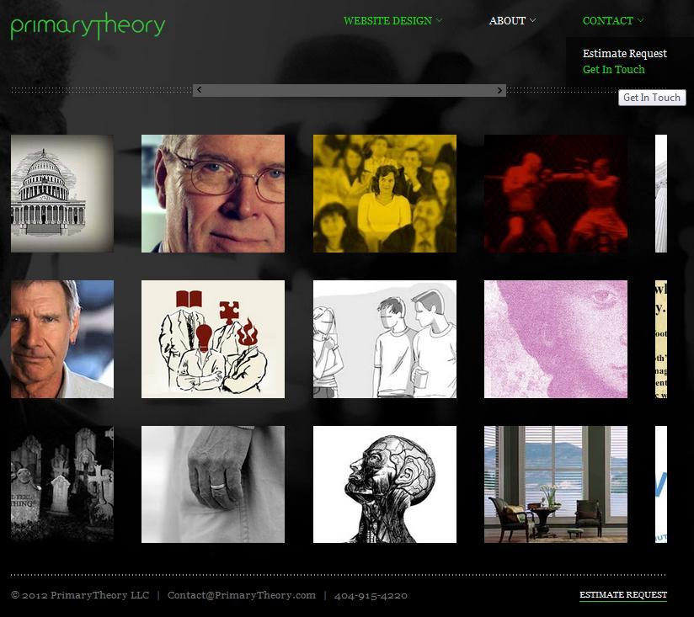
Interactivity
The top tab has a drop-down menu when you hover your mouse over it. Your selection is also highlighted during mouse-over.
The showcase is displayed by a grid with a side-scrolling bar.
Each link will bring you to a new page, but the top tabs remain.
Each page for their work has a video that auto-plays.

Slide 36
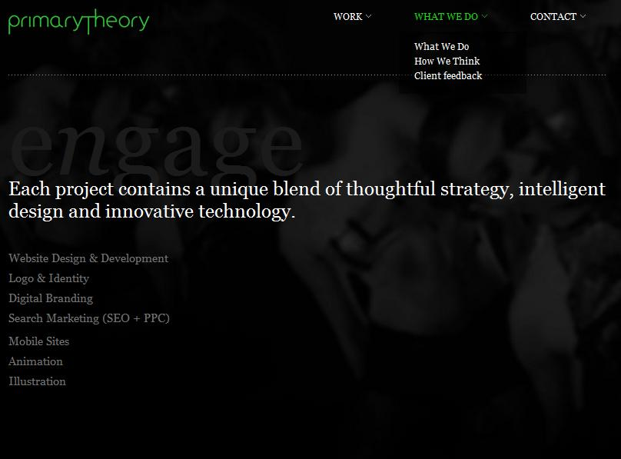
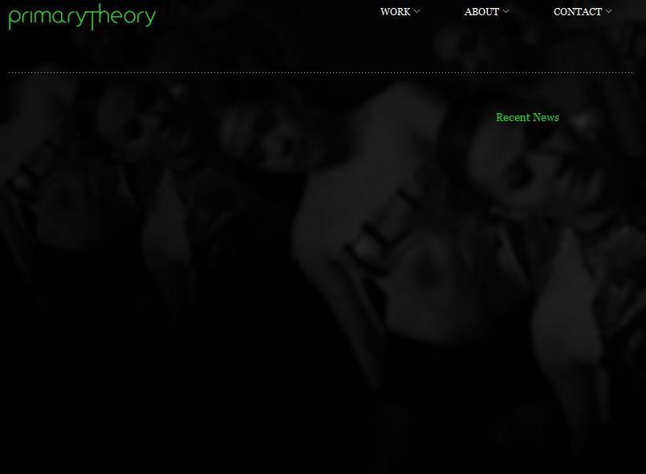
Navigation
The top tab is always there to direct you back to the main pages.
When you are in a page under one of the main tabs, the tab’s name will change into the name of the page you are on.
One problem I found is that some of the links are dead. Or they simply lead you back to the web design page. I don’t know if their site is unfinished, but it was very confusing.

Slide 37
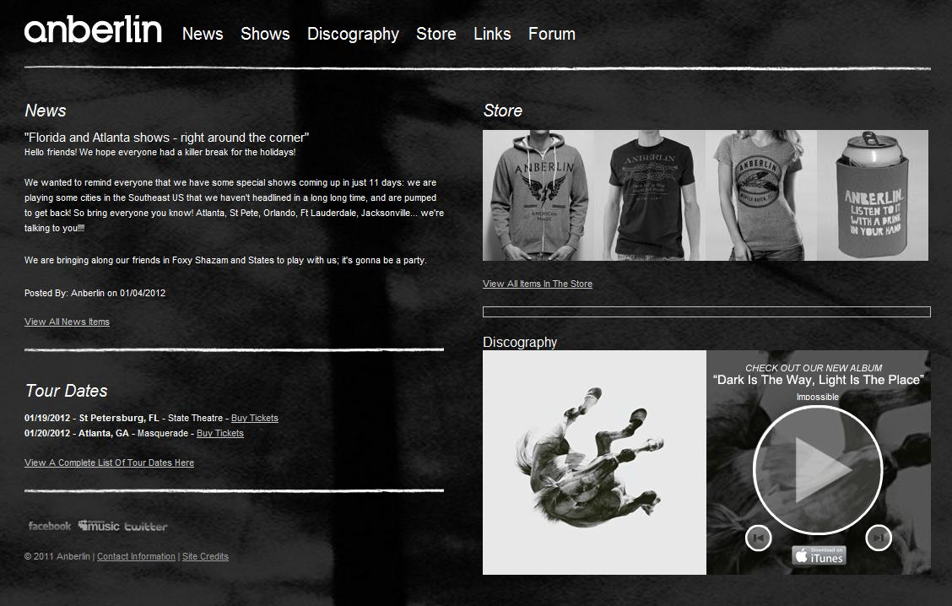
8) Anberlin
www.anberlin.com
Date Visited: 1/19/12
Layout: Full Screen Photo

Slide 38
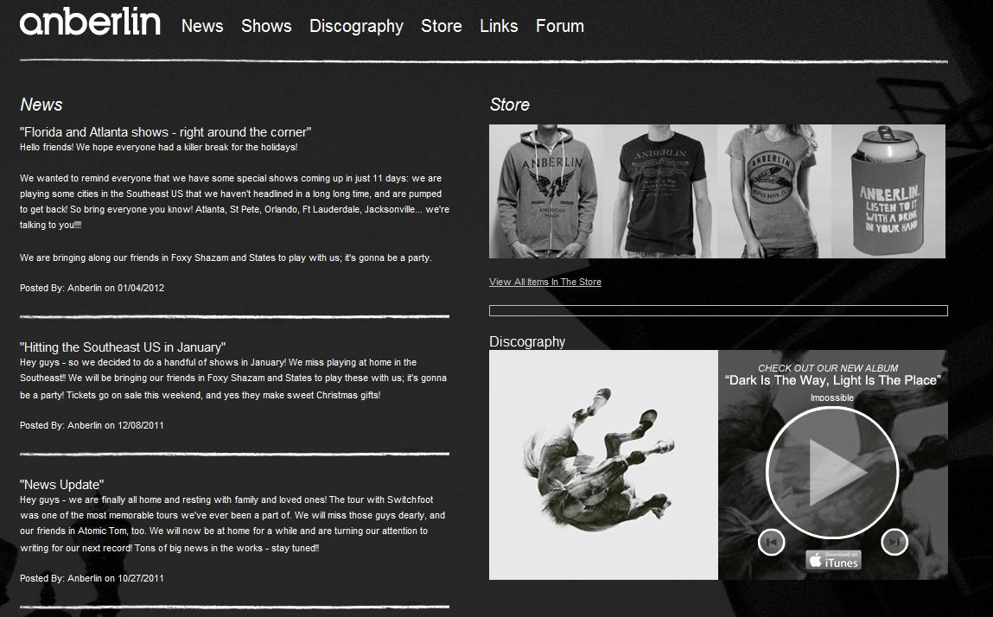
Brand
Professional – The front page shows their discography and store right away.
Social – They advertise themselves in a way so that you can check them out. Including a forum.
Friendly – Their news posts are friendly and fun.

Slide 39
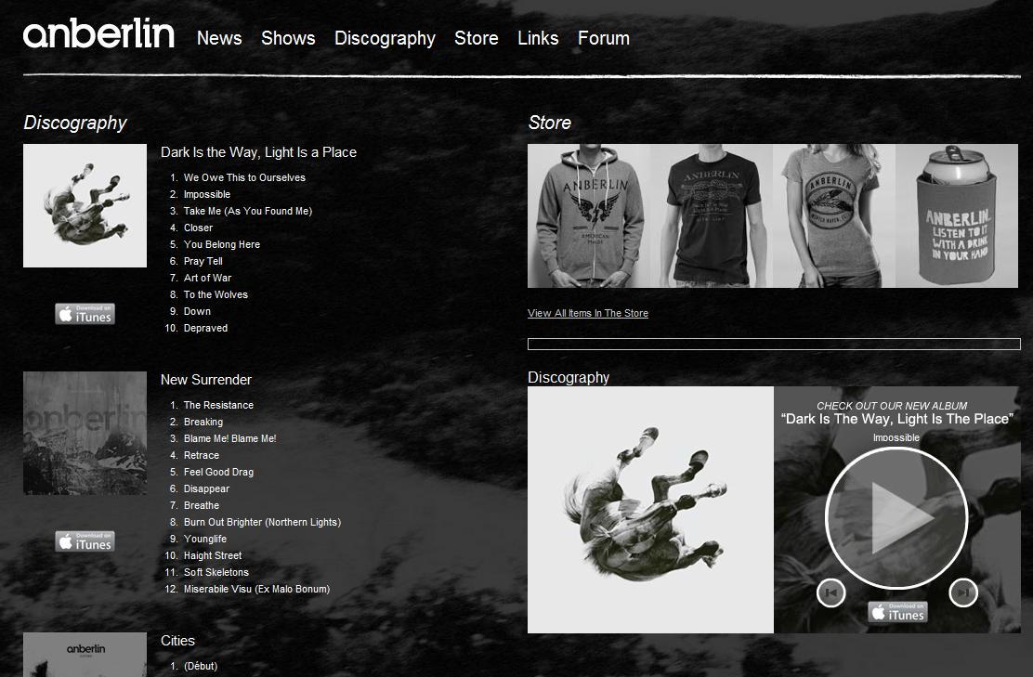
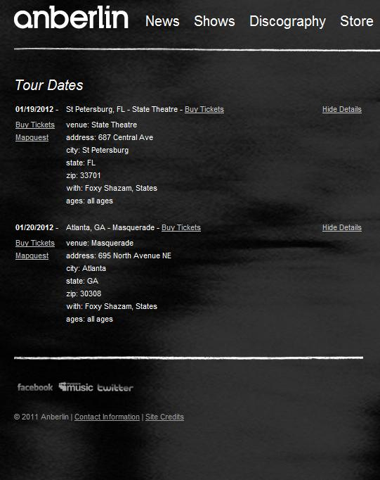
Functionality
The tab on the top is always present.
The show details are displayed with links to the location and tickets. I don’t know why the ticket link is displayed twice though.
The pictures under the store can be selected for more details on the product. It will bring you to their store’s page.
Their discography shows all their songs and albums. You can only listen to their most recent album though.
You can select the album cover to purchase them from iTunes.

Slide 40
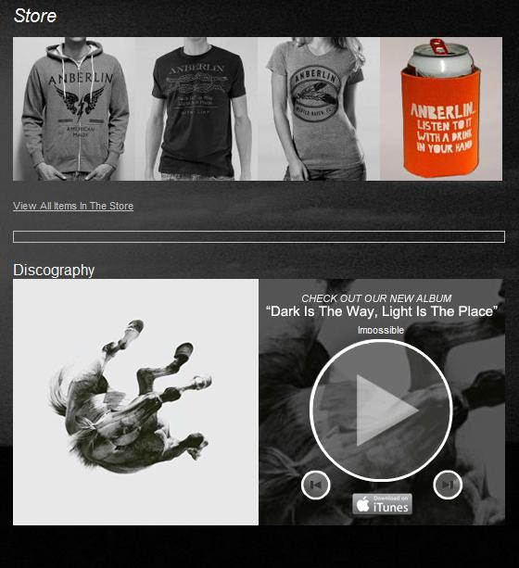
Interactivity
Most interaction on the site is done through links. Everything lights up or gains color after a mouse-over.
Clicking on the store will bring you to their store page, which is separate.
You can choose to play songs from their latest album.
Some of their pages have options to hide or show info.

Slide 41
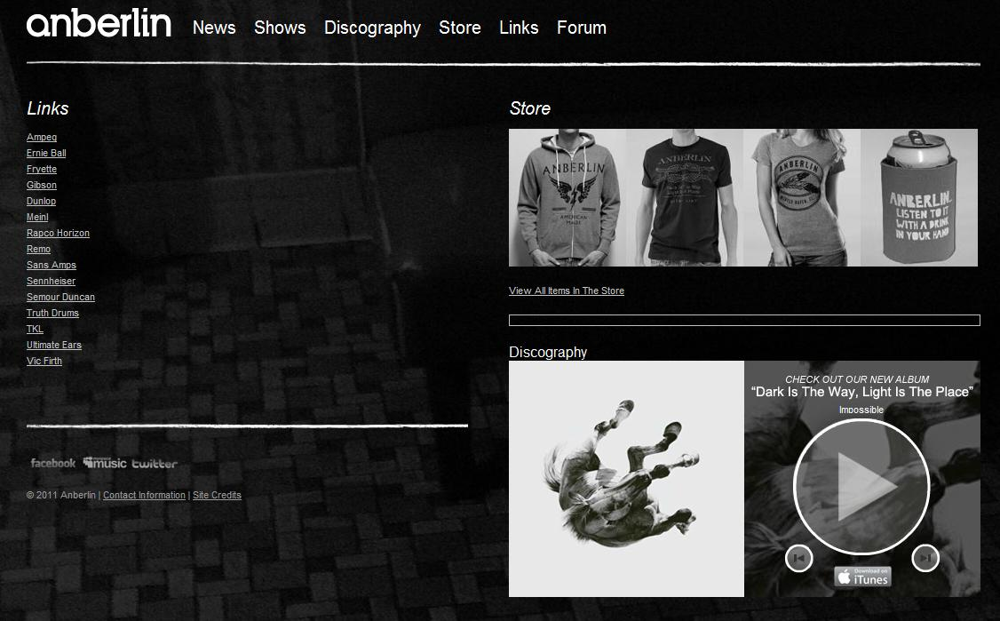
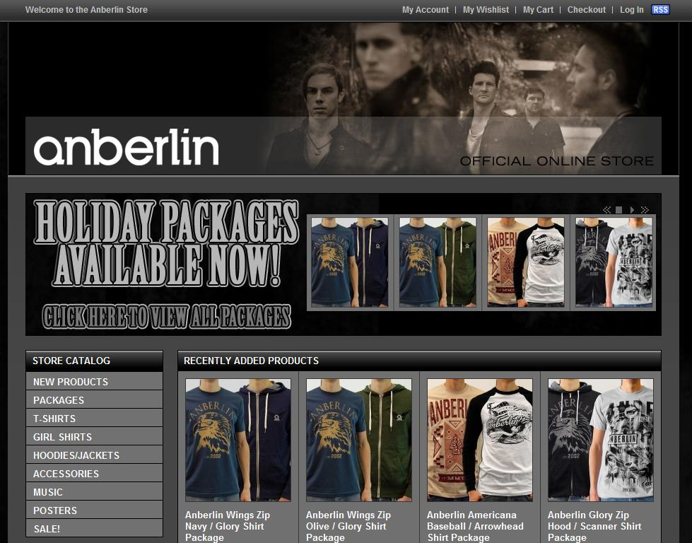
Navigation
The top tab will always guide you to any page you want to go.
The Store and Forum links bring you to and window. I personally didn’t like this.
One problem I saw is that the Store and Discography sections are present on almost every page, which shows me that they don’t have much else to fill the page.

Slide 42
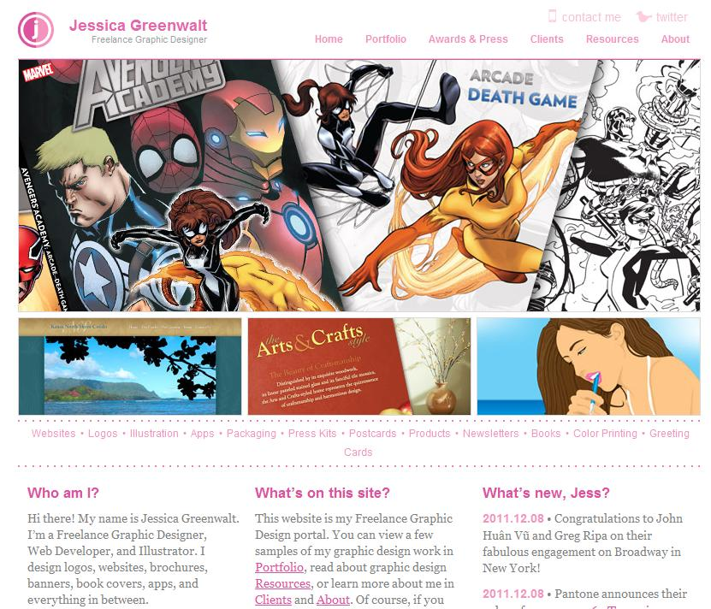
9) Jessica Greenwalt – Freelance Graphic Designer
www.jgreenwalt.com
Date Visited: 1/19/12
Layout: Four Boxes

Slide 43

Brand
Skilled – The front page showcases some of her work. She also has awards to boast with.
Friendly – She acts approachable and easy-going. She allows comments.
Diverse – Has a lot of different style available to use.

Slide 44


Functionality
The links on the top tab and side tabs show everything on the site.
Selecting a design will bring you to a picture of the site.
The search bar also works. I don’t really think it is that useful for such a small site though.

Slide 45



Interactivity
Most of the interactivity consists of highlighting the links during a mouseover and selecting images in her portfolio for a quick look at her work.
She allows you to leave a comment on some of her pages.

Slide 46
Navigation
Navigation is mostly done through the top tab and the sidebars.
One problem I found is that at first glance, the sidebar seems to correspond with the images in the portfolio. This is not the case though. The sidebar tabs lead you to another page with works under that category. The images on the right lead you straight to that design’s page.
There is a resources page for more info on the basics of graphic design. I found this to be a neat feature on a portfolio.
Again, the search function doesn’t seem useful for such a small site.

Slide 47

10) HMC Architects
hmcarchitects.com
Date Visited: 1/19/12
Layout: Custom (Interactive Featured Photo)

Slide 48

Brand
Innovative – The layout is pretty unique with the interactive menus and slideshow.
Professional – They are very serious about what they do and proud of what they’ve done.
Clean – They don’t go very wild with their designs, despite the unique layout.

Slide 49


Functionality
The whole site is interactive. The tabs have a pop-up menus when selected. When you move to a new page, the middle slideshow also changes according to the page.

Slide 50


Interactivity
The whole site is interactive, mainly controlled by mouse-overs. The main menu appears if you mouse-over the HMC logo. The middle sidebar appears if you mouse-over it. It will also scroll with your cursor.
One problem is that mouse-overs control too much. There is a lack of control. If you accidently mouse-over something, your current page may disappear. Although it will reappear if you bring your mouse back to the right position, it is pretty annoying.

Slide 51


Navigation
Navigation is rough because the menu’s are not always visible. Since mouse-overs control everything, you need to constantly hover over things to see the whole page. I feel that this hinders people from seeing everything on the site.
There is a site map though, which does help with this problem.
There is a site map though, which does help with this problem.

Slide 52
Sketch
After viewing all these sites, I came up with a few features that I really liked seeing in portfolios. I also came up with some that I would never use in my own site.
Liked Features
Main Navigation Bar
Simple Color Scheme
Highlighting Links by Mouse-over
Menus Activated via Clicking
Different Background Images (if any)
Ability to Select/Enlarge Images
Disliked Features
Mouse-over Menus
Side-Scrolling
Bottom Navigation Tab
Search Function
Fully Interactive Navigation
Single-Page Portfolios

Slide 53

This is a rough sketch of what I would like my portfolio’s homepage to look like. My basic layout will be similar to Three Boxes. I like this layout because it is simple and easy to display content. Five boxes is a bit too much for me at the moment, but I may consider it once I have more content to put up.
I like the side navigation along with the main navigation tab at the top so you always know where you are. I would hate to have to use a site map.
Header

